Slide 1
Computer Networks (4th Edition) Andrew S. Tanenbaum
主讲教师: 陆魁军
Email: lukj@zju.edu.cn
浙江大学计算机学院
310027 浙江 杭州 玉泉校区
© Copyright 2003 by lu kui jun in computer department of Zhejiang university, All right reserved.

Slide 2
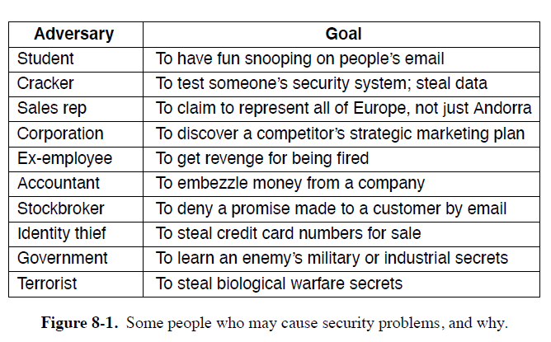
8 NETWORK SECURITY

Slide 3
8.1 Fundamentals of Network Security
Confidentiality
Keeping information away from unauthorized users
Integrity
Ensuring information received is what was really sent
Availability
Preventing systems and services from becoming unusable
Authentication
Deals with determining whom you are talking to before revealing sensitive information or entering into a business deal
Nonrepudiation
Deals with signatures

Slide 4
Considerations in each layers:
Physical layer：protecting transmission lines
Data link layer：link encryption
Network layer: firewalls, IPsec(a protocol for IP security that encrypts packet payloads)
Transport layer：entire connections can be encrypted, end to end
Application layer：authentication and nonrepudiation ……
Except for physical layer security, nearly all security is based on cryptographic principles.

Slide 5
8.4 CRYPTOGRAPHY
Cryptography
Comes from the Greek words for “secret writing”
Has a long and colorful history going back thousands of years
Distinction between ciphers and codes
cipher：is a character-for-character or bit-for-bit transformation, without regard to the linguistic structure of the message
codes：replaces one word with another word or symbol
Tips about codes
Codes are not used any more, although they have a glorious history
The most successful code ever devised was used by the U.S. armed forces during World War II in the Pacific

Slide 6
8.4.1 Introduction to Cryptography
The encryption model：-[see fig 8-9]
plaintext(P)、key(K)、ciphertext(C)、intruder、cryptanalysis、cryptology
C=E_{K}(P)
D_{K}(E_{K}(P))=P
Kerckhoff’s principle:
All algorithms must be public;only the keys are secret
The length of key:
The computation time (i.e., work factor) by exhaustive search of key is exponential in the key length.
The cryptanalysis problem has three principal variations:
Cipher text-only problem: When a cryptanalyst has a quantity of ciphertext and no plaintext, he is confronted with a ciphertext-only problem.
Known plaintext problem: has some matched ciphertext and plaintext.
Chosen plaintext problem: when the cryptanalyst has the ability to encrypt of his own choosing, we have the Chosen plaintext problem

Slide 7
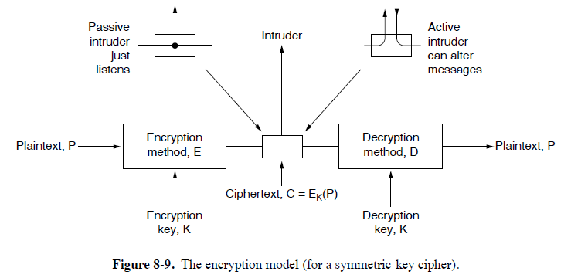
8.1 CRYPTOGRAPHY

Slide 8
8.4.2 Two Fundamental Cryptographic Principles
All encrypted messages must contain some redundancy.
The redundancy can prevent active intruders from cheating receivers
However, this same redundancy makes it much easier for passive intruders to break the system
A random string of English word would be a better choice for the redundancy.
Some measures must be taken to ensure that each message received is the latest one (not a repeated one).
One such measure is including in every message a timestamp valid only for, say, 10 seconds.

Slide 9
8.4.3 Substitution Ciphers
Each letter or group of letters is replaced by another letter or group of letters to disguise it
plaintext letter is x, ciphertext letter is y, y=f(x) is decided by following table:
attack --> QZZQEA
Caesar cipher,monoalphabetic substitution
plain: a b c d e f g h i j k l m n o p q r s t u v w x y z
cipher:d e f g h i j k l m n o p q r s t u v w x y z a b c
Method of breaking the Substitution Ciphers: utilizing the frequency statistics of English letters, e,t,o,a,n,i

Slide 10
8.4.4 Transposition Ciphers
reorder the letters but do not disguise them [see fig 8-10]
key is MEGABUCK, i.e., 74512836
The purpose of the key is to number the columns
X and Y are 64-letter sequence, we denote X = X₆₃ X₆₂ ... X₁ X₀，Y = Y₆₃ Y₆₂ ... Y₁ Y₀，Y=f(X) is decided by following table:
Some transposition ciphers accept a fixed-length block of input and produce a fixed-length block of output

Slide 11
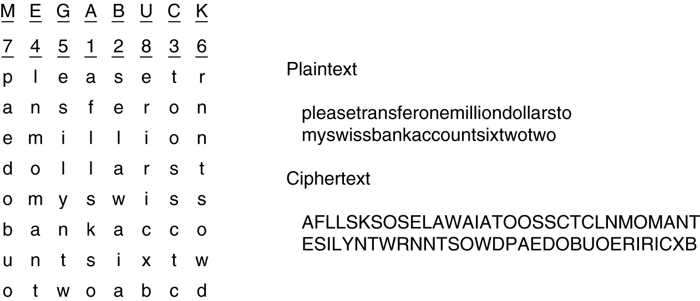
Fig.8.10 A transposition cipher.

Slide 12
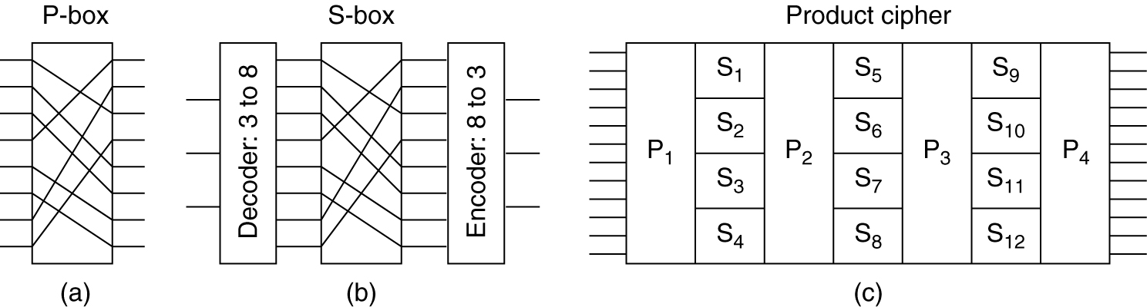
8.5 SYMMETRIC-KEY ALGORITHMS
Making encryption algorithm as complex as possible, so that the cryptanalyst makes no sense of it.
Transpositions and substitutions can be implemented with simple circuits. [fig 8-13]
Fig.8.13 Basic elements of product ciphers. (a) P-box. (b) S-box. (c) Product.

Slide 13
Implementation with simple circuit for substitution and transposition. -[see fig 8-13(a)(b)]
Substitution---S-Box
Plaintext character x(3 bit), ciphertext character y(3 bit), y=f(x) is decided by following left table:
Permutation=Transposition---P-Box
X,Y are sequences of 8 bit, X = X₇ X₆ ... X₁ X₀，
Y = Y₇ Y₆ ... Y₁ Y₀，Y=f(X) is decided by above right table:
The real power thing is the product
By inclusion of a sufficiently large number of stages in the product,the output can be made to be an exceedingly complicated function of the input.
X | 0 | 1 | 2 | 3 | 4 | 5 | 6 | 7
Y | 2 | 4 | 5 | 0 | 6 | 7 | 1 | 3

Slide 14
8.5.1 DES-The Data Encryption Standard
DES Algorithm
Data Encryption Standard（DES） -[see fig K8-5]
principle：
64 bit plaintext、56-bit key、yielding 64 bits of cipher
19 distinct stages
Triple DES- [see fig 8-14]
The DES key length was too short and IBM devised a way to effectively increase it by using triple encryption
The reason that two keys are used is that even the most paranoid (过分猜疑的) cryptographers believe that 112 bits is adequate for routine commercial applications for the time being
The reason for encrypting, decrypting, and then encrypting again is backward compatibility with existing single-key DES systems.

Slide 15
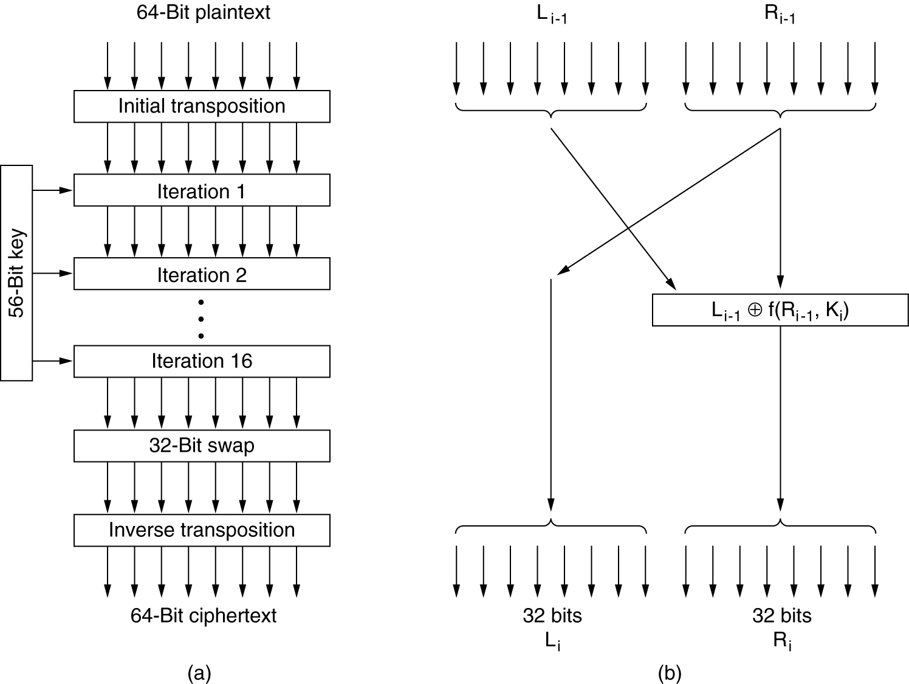
Fig.K8.5 The data encryption standard. (a) General outline. (b) Detail of one iteration. The circled + means exclusive OR.

Slide 16
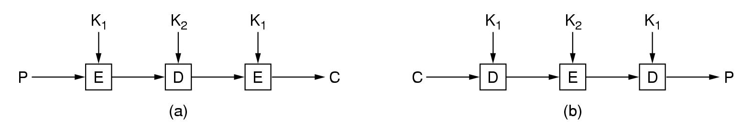
Fig.8.14 Triple encryption using DES

Slide 17
(补充)
数据加密标准DES
DES（Data Encryption Standard)属于常规密钥密码体制
DES基于IBM的Lucifer密码（128位密钥）
DES是一种分组密码。在加密前，先对整个的明文进行分组。每一个组长为64bit。然后对每一个64bit二进制数据进行加密处理，产生一组64bit密文数据。最后将各组密文串接起来，即得出整个的密文。
使用的密钥 K 为64 bit(实际密钥长度为56 bit，有8bit用于奇偶校验)
初始变位IP，逆变换IP⁻¹，都是64bit--->64bit的一种确定不变的变位密码，对任意的64bit明文X，恒成立：
IP⁻¹( IP(X) ) = IP( IP⁻¹(X) ) = X

Slide 18
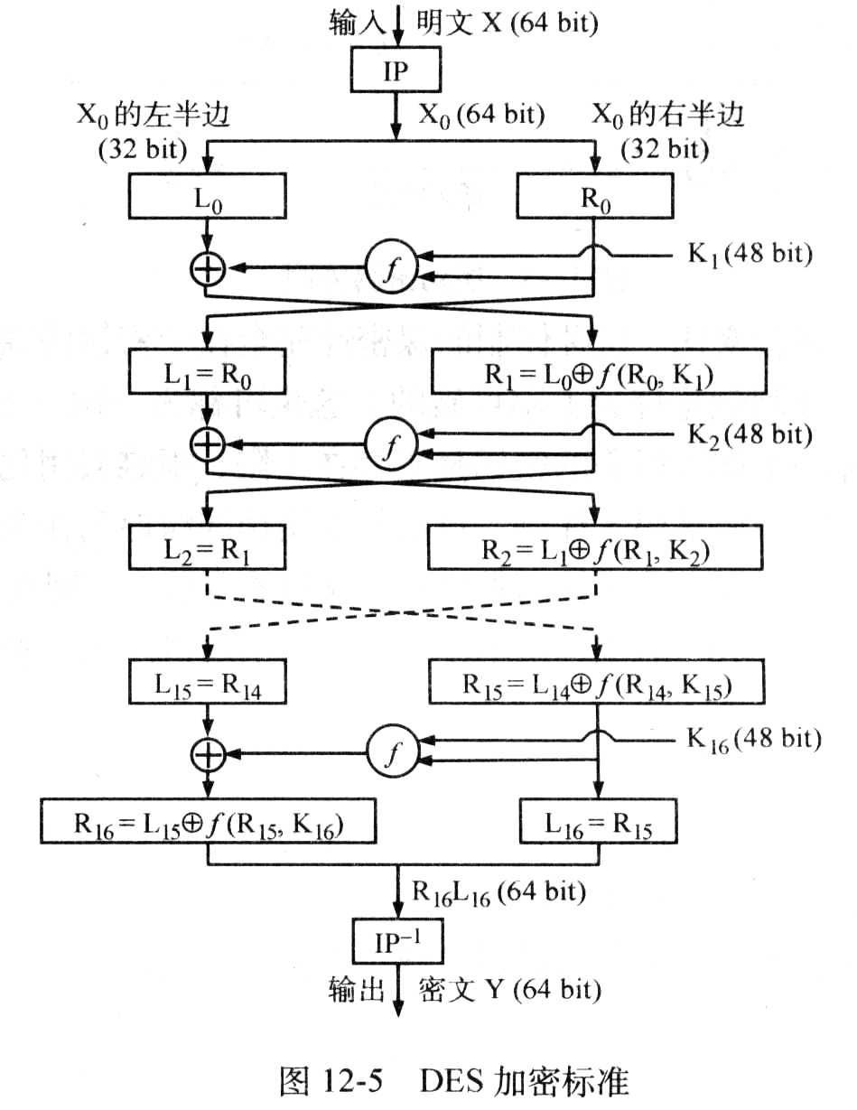
(补充)

Slide 19
(补充)
原来的64bit密钥 K，经过若干次复杂的变换（包括移位和变位）而得出K1，k2，…，k16，Ki是48bit密钥。
（L0,R0）--->(L1,R1)， （L1,R1）--->(L2,R2)， …… , （L15,R15）--->(L16,R16)， 16次的迭代。如果用Xi表示第i次的迭代结果，同时令L_{i}和R_{i}分别代表Xi的左半边和右半边(各32bit)，则从图12-5可看出：
L_{i} = R_{i-1} R_{i} = L_{i-1} ⊕ f(R_{i-1} ,K_{i})
函数f是个非常复杂的变换(其复杂变化的细节都未画出),使用2次变位，一次⊕ 运算，8个S-box的映射。
DES解密过程和加密相同，但使用16个密钥的顺序正好相反。

Slide 20
8.5.2 AES-The Advanced Encryption Standard
Rules for AES proposals
The algorithm must be a symmetric block cipher.
The full design must be public.
Key lengths of 128, 192, and 256 bits supported.
Both software and hardware implementations required
The algorithm must be public or licensed on nondiscriminatory terms.
In November 2001, NIST, Federal Information Processing Standard (FIPS) 197
Rijndael = Rijmen + Daemen, two young Belgium cryptographer.
Rijndael supports key length and block sizes from 128 to 256 bits in steps of 32 bits.
AES specifies that the block size must be 128 bits and the key length must be 128, 192,256 bits

Slide 21
Rijndael-[see fig K8-7]
Based on Galois field theory (群论).
Uses substitution and permutations, and it also uses multiple rounds.
All operations involve entire bytes (128 bits), to allow for efficient implementations in both hardware and software.

Slide 22
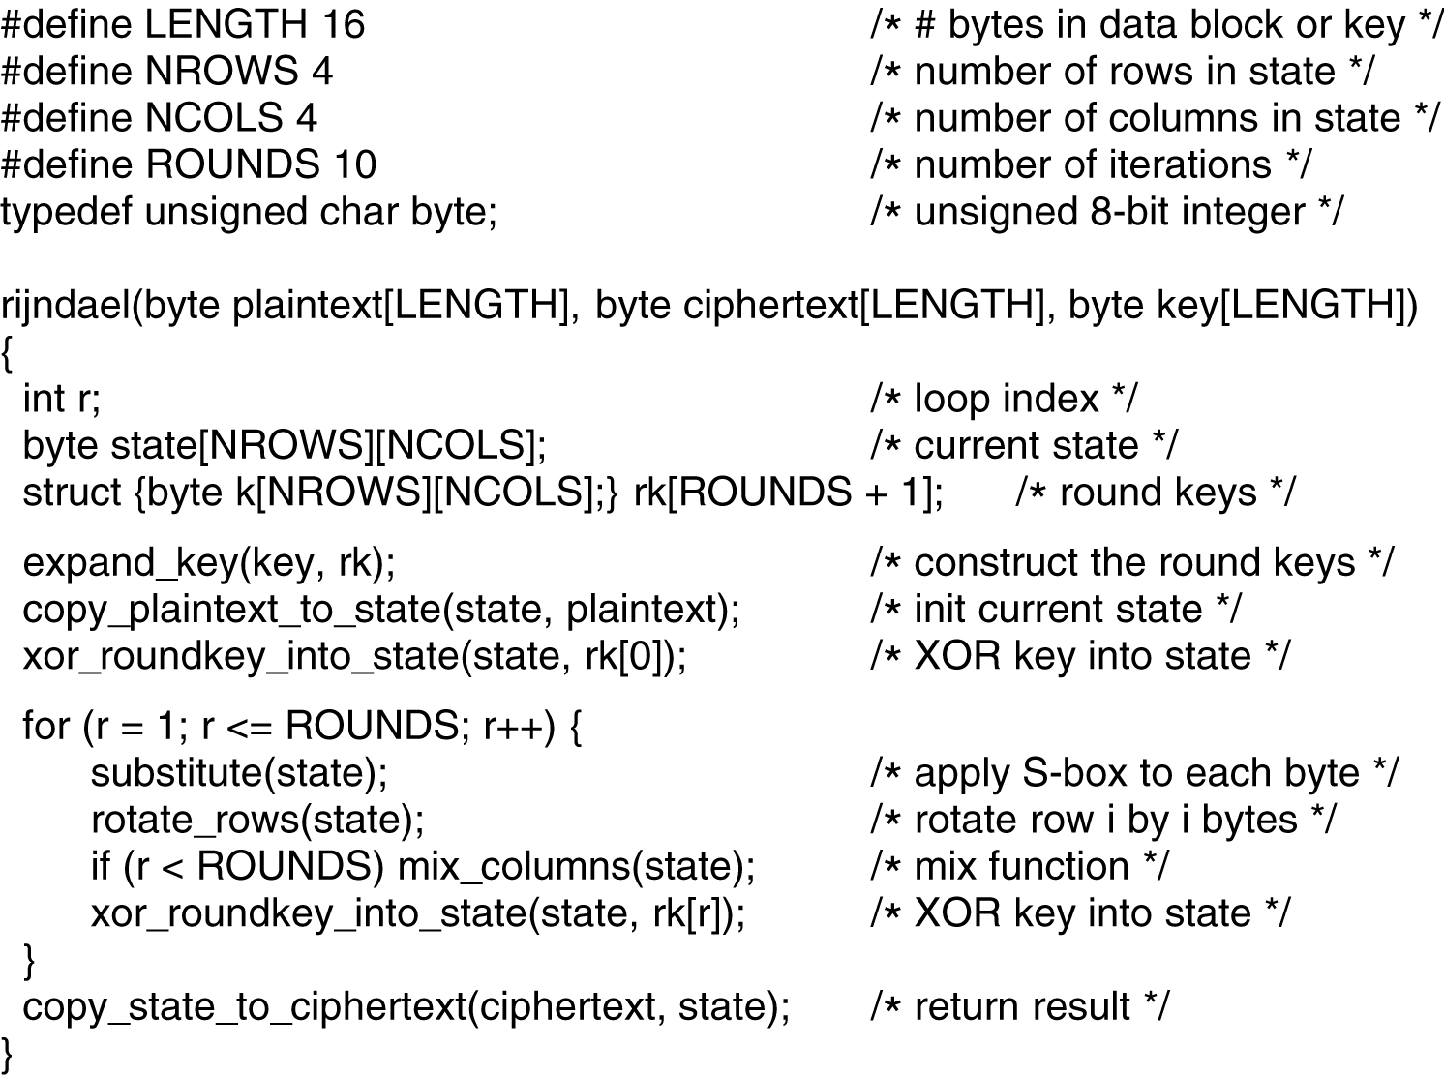
第6版教材已去掉细节
Fig.K8.7 An outline of Rijndael.

Slide 23
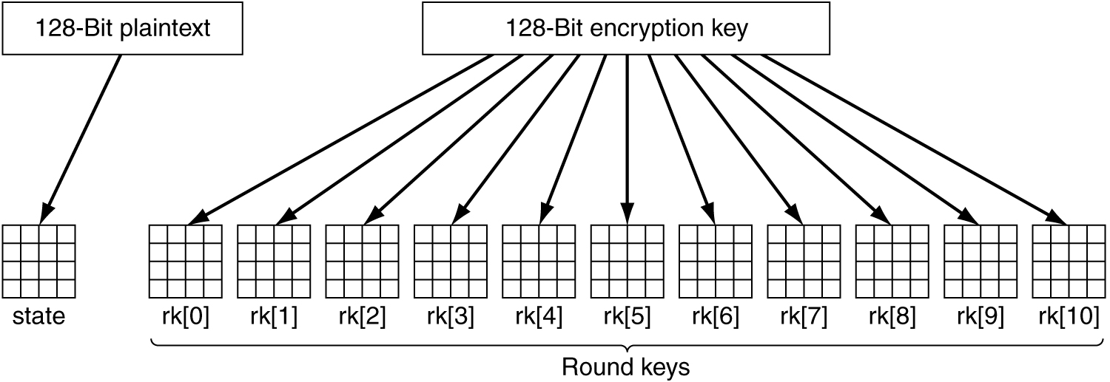
第6版教材已去掉细节
The function rijndael has three parameters:
Plaintext : an array of 16 bytes containing the input data
Ciphertext:an array of 16 bytes where the enciphered output will be returned
Key: the 16-byte key
Creating of the state and rk arrays:-[see fig K8-8]
Fig K8.8 Creating of the state and rk arrays.

Slide 24
Steps of the rijndael function:
Expanding the key into 11 arrays of the same size as the state
11 round keys are produced by repeated rotation and XORing of various groups of key bits.
Copy the plaintext into the state array so it can be processed during the rounds
Rk[0] is XORed into state byte for byte
Loop for round times:
Do a byte-for-byte substitution on state
each byte is used as an index into a single S-box , and that byte’s value is replaced by the S-box entry.
Rotates each of the four rows to the left: row 0 is rotated by 0 bytes, row i (i=0--3) is rotated by i bytes,...
Mixes up each column independently of the other ones
The new column of state is the product of the old column and constant matrix, the multiplication uses the finite Galois field, GF(2⁸)
XORs the key Rk[i] for this round into the state array
Copy state to ciphertext.

Slide 25
The decryption can be done just by running the algorithm backward, it also can be done by running the encryption algorithm using different tables.
8.5.3 Cipher Modes
AES (or DES) is basically a monoalphabetic substitution cipher using big characters
128-bit character for AES, and 64-bit for DES
Whenever the same plaintext block goes in the front end, the same ciphertext comes out the back end.
Electronic code book mode-[see fig 8-11]
Cipher block chaining Mode-[see fig 8-12]
IV (Initialization Vector)

Slide 26
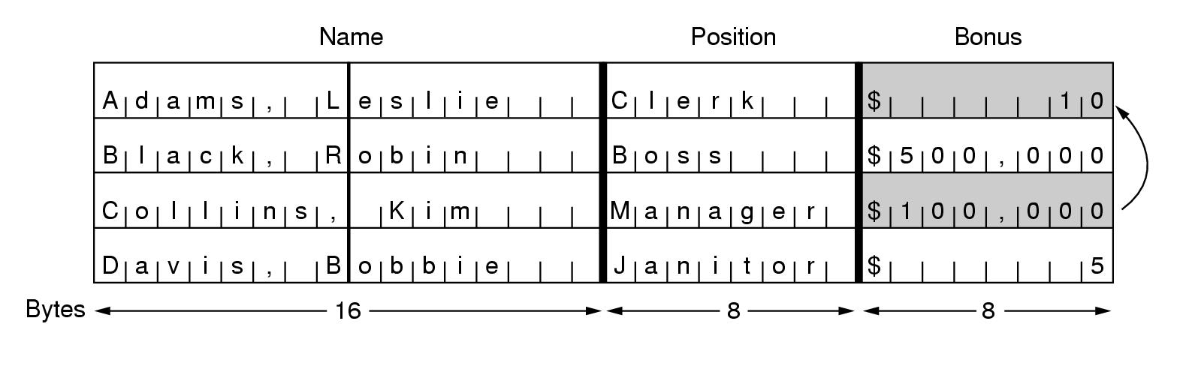
Fig. 8-15. The plaintext of a file encrypted as 16 DES blocks.

Slide 27
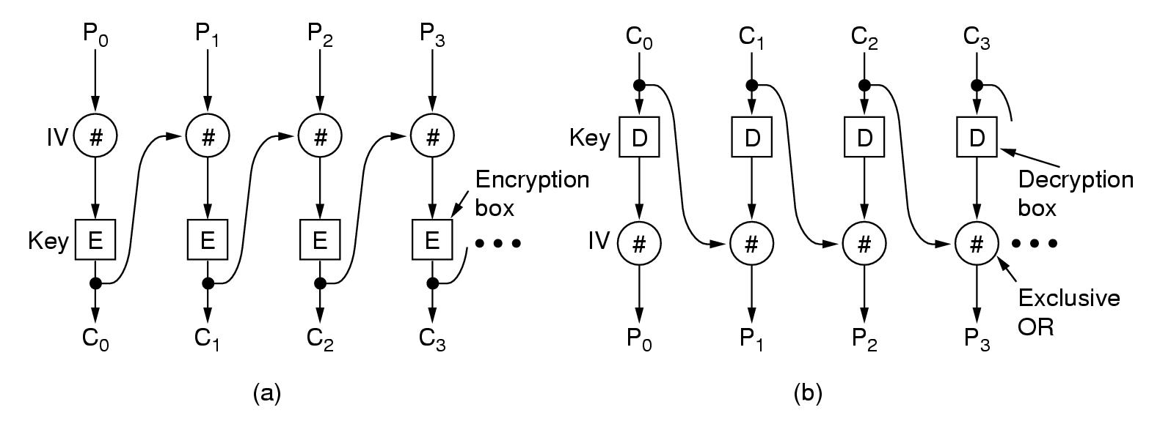
P1 XOR C0
XOR C0
P1 XOR C0
P1 XOR C0
Fig. 8-16. Cipher block chaining

Slide 28
8.6 PUBLIC-KEY ALGOTITHMS
Historically, the key distribution problem—the weak link in most cryptosystems.
Diffie and Hellman, 1976, public-key cryptography
E----the encryption algorithm, public
D----the decryption algorithm, public
encryption key PK, are made public ---- public key
Decryption key SK is kept secret ---- private key
In public-key cryptography, the encryption and decryption keys are different, which requires:
D_{SK}(E_{PK}(P))=P
It is exceedingly difficult to deduce SK from PK.
E can not be broken by a chosen plaintext attack.
Public-key cryptography
Each user has two keys: a public key and a private key

Slide 29
Alice’s public key PKA, security key SKA
Bob’s public key PKB, security key SKB
Alice wants to send message P to Bob, so she encrypts it with Bob’s public key, the result ciphertext is E_{PKB}(P) .
Alice sends the ciphertext E_{PKB}(P) to Bob, Bob decrypts it with his security key (SKB), the result is D_{SKB}(E_{PKB}(P) )=P.
Only Bob can decrypts E_{PKB}(P), others can’t decrypt it.

Slide 30
8.6.1 RSA Algorithms
RSA Algorithm（Based on difficulty factoring large number.)
Devised by Rivest,Shamir and Adleman at MIT.
Based on some principles from number theory (数论)：
Choose two large primes, p and q, (typically 1024 bits).
Compute n = p x q and z = (p-1) x (q-1).
Choose a number d relatively prime to z.
Find e such that e x d = 1 mod z.
To encrypt message P，compute C = P^{e} mod n,
encrypt function f(x), f(x)= x^{e} mod n
To decrypt C，compute P = C^{d} mod n.
decrypt function g(x), g(x)= x^{d} mod n
example of RSA algorithm
p=3,q=11,so n=33, z=20
select d=7, solving equation: 7*e=1 mod 20,e=3
C=P³ mod 33, P=C⁷ mod 33

Slide 31
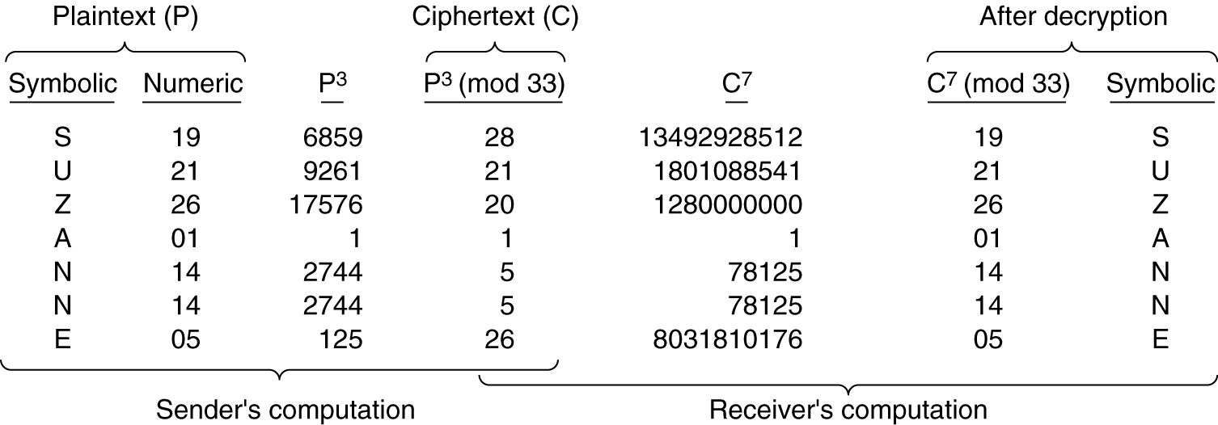
Figure 8-19. An example of the RSA algorithm

Slide 32
(补充)
RSA算法计算实例。
（1）密钥的产生：设选择了两个素数，p=7，q=17。
计算n=pq=7×17=119， 计算z=(p-1)(q-1)=96
从[0，95]中选择一个与96互素的数d。我们选d= 77 。从下式
e* 77 = 1 mod 96
解出e=5，因为 e*d = 5 × 77 = 385 = 4×96+1 = 1 mod 96。
于是，公开密钥PK=(e，n) = {5，119}，而秘密密钥SK={77，119}。
（2）用刚才产生的密钥对，对明文进行加密。首先将明文划分为一个个分组，使得每个明文分组的二进制值不超过n。即不超过119。现在设明文 X=19。

Slide 33
(补充)
用公开密钥加密时，先计算Xe = 19^5 = 2476099。再除以119，得出商为20807，余数Y为66，所以密文 Y=66。
接收方在用秘密密钥SK={77，119}进行解密时，利用公式
(x * y) % n = [(x % n) * (y % n)] % n
(x ^ y) % n = [(x % n) ^ y] % n
解密计算
X = Y^{d} mod 119 = (66 ^77) % 119
= [66* ((66^4)^19)] % 119
= [66* (18974736^19)] % 119
= [66* ((18974736 % 119)^19)] % 119
= [66* (67 ^ 19)] % 119
= [66* 67*(67 ^ 18)] % 119

Slide 34
(补充)
= [19*( (67^2) % 119) ^ 9)] % 119
= [19*(86^ 9)] % 119
= [19*86*(86^ 4 ^2)] % 119
= [87*(86^2)] % 119
= [87*18] % 119 = 19，明文 X=19
在上面的计算中利用了：(66* 67) % 119 = 19
(19*86) % 119 = 87
(86^ 4) % 119 = 86
(86^2) % 119 = 18

Slide 35
8.7 DIGITAL SIGNATURES
The authenticity of many legal, financial, and other documents is determined by the presence or absence of an authorized handwritten signature.
Basically, Digital Signatures System need hold the following conditions:
The receiver can verify the claimed identity of the sender.
The sender can not later repudiate the contents of the message.
The receiver cannot possibly have concocted the message himself.

Slide 36
8.7.2 Public-Key Signatures
It will be better if signatures don’t need any trusted organizations.
Public-key cryptography can meet this requirement.
E_{PK}(D_{SK}(P))=P and D_{SK}(E_{PK}(P))=P (RSA has this property)
Process of digital signatures-[see Fig 8-22]
characteristics：
If one discloses his secret key, the reliability no longer exists.
When the private key is changed periodically, some authority is probably needed to record all key changes and their dates.
In principle, any public-key algorithm can be used for digital signatures.
RSA algorithm: a de facto (事实上的) industry standard for digital signature.

Slide 37
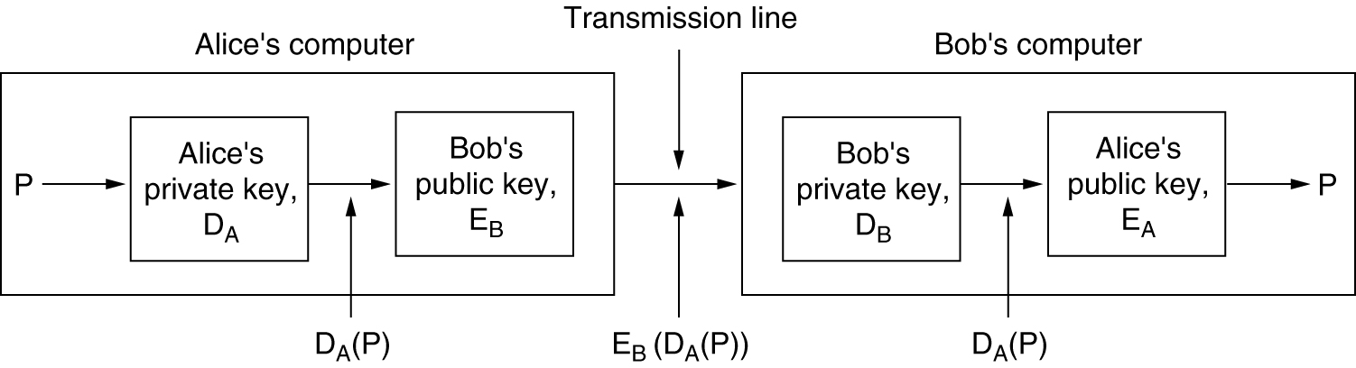
Figure 8-22. Digital signatures using public-key cryptography

Slide 38
8.7.3 Message Digests
Signature methods above often couple two distinct functions: authentication and secrecy. Often, authentication is needed, but secrecy is not.
Message Digests principle：based on the idea of a one-way hash function that takes an arbitrarily long piece of plaintext and computes a fixed-length bit string from it .
Three important properties：
Given P, it is easy to compute MD(P).
Given MD(P), it is effectively impossible to find P.
No one can generate two messages that have the same message digest. To meet this, the hash should be 128 bit long at least.
Message digests may work in public-key cryptosystems-[see Fig 8-23]
Main implementation of message digests:
MD5（Rivest, 1992）
SHA（NIST，1993） Secure Hash Algorithm

Slide 39
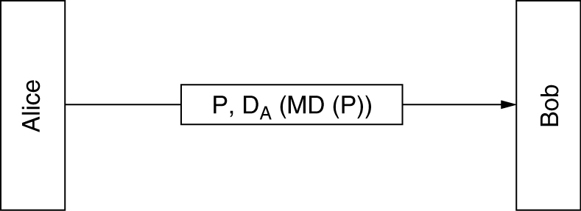
Figure 8-23. Digital signatures using message digests

Slide 40
第6版教材已去掉本页内容
MD5（Rivest, 1992）,Mangling input bits in a sufficiently complicated way that every output bit is affected by every input bit.
It start by padding the message to a length of 448 bit (modulo 512)
448+64=512: then the original length of the message is appended as a 64-bit integer, so that the total length of the message is multiple of 512 bit.
Initializing a 128-bit buffer to a fixed value.
Each computation round takes a 512-bit input block.
It fetches 128 bit from the block and mix it with the 128-bit buffer. The mixing utilizes a table constructed from the sine function .
The above mixing runs 4 times for a 512-bit block.
This process continues until all the input blocks are consumed. The result contents of 128-bit buffer form the message digest.

Slide 41
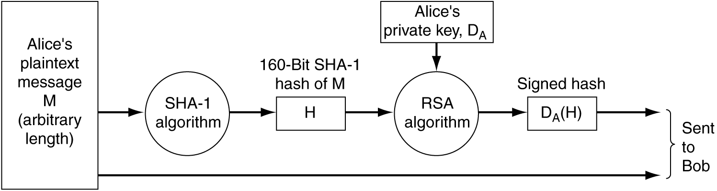
SHA-1
Secure Hash Algorithm 1 is developed by NSA and blessed by NIST in FIPS 180-1.
Like MD5, SHA-1 processes input data in 512-bit blocks, only unlike MD5, it generates a 160-bit message digest.
Figure 8-24. Use of SHA-1 and RSA for signing nonsecret messages.

Slide 42
8.8 MANAGEMENT OF PUBLIC KEYS
Public-key cryptography make it possible for people who do not share a common key to communicate securely.
It also makes signing messages possible without the presence of a trusted third party.
How do people get each other’s public-keys to start the communication process?
The obvious solution is put your public key on your Web site. [see fig 8-25]
And some mechanism is needed to make sure that public keys can be exchanged securely.

Slide 43
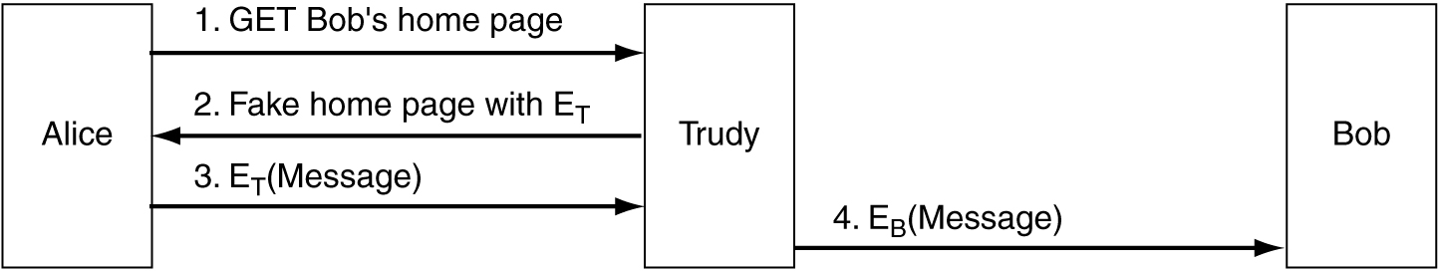
Figure 8-25. A way for Trudy to subvert public-key encryoption.

Slide 44
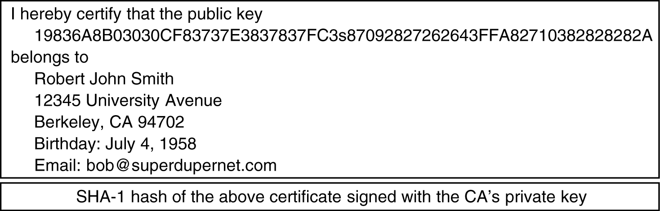
Figure 8-26. A possible certificate signed with the CA’s private key.

Slide 45
8.8.1 Certificates
solution to public key exchange securely: A key distribution center available all day to provide public key on demand.
problems: it is not scalable
problems: the key distribution center would rapidly become a bottleneck.
Another different solution that not require the key distribution center to be online all the time.
But it need an organization called a CA (Certification Authority)
The fundamental job of a certificate is to bind a public key to the name of a principle (主体) ( individual, company, etc.).
A certificate like fig. 8-26 can be put on web page of John Smith.
If Trudy replaces the content of certificate with hers, user will find the difference.

Slide 46
If Trudy replaces only the digit string of public key with her own,
user runs SHA-1 algorithm on the certificate, and gets a hash.
This hash will be different from the one he gets when he applies the CA’s well known public key to the signature block.
A certificate can also be used to bind a public key to an attribute.
A certificate distributed by a famous CA could say: This public key belongs to someone over 18.
It could be used to prove the owner’s age, but without disclosing his identity.
When the certificate owner sends it to the Web site, the site generate a random number, encrypt it with the public key of the certificate, and ask the owner to decrypt it.
If the owner could decrypt the number using secret key and return it to the Web site, he will be the true owner of the certificate.

Slide 47
8.8.3 Public Key Infrastructures
Having a sinle CA to issue all certificates would not work: excessive load, central point of failure.
It is hard to imagine any authority that would be accepted worldwide as CA.
For these reasons, PKI (Public Key Infrastructure) has evolved.
The top-level CA, the root, certifies second-level CAs, which we call RAs (Regional Authorities).
RA might cover some geographic region.
These RAs certify the real CAs, which issue the X.509 certificates to organizations and individuals. [Fig 8-28]

Slide 48
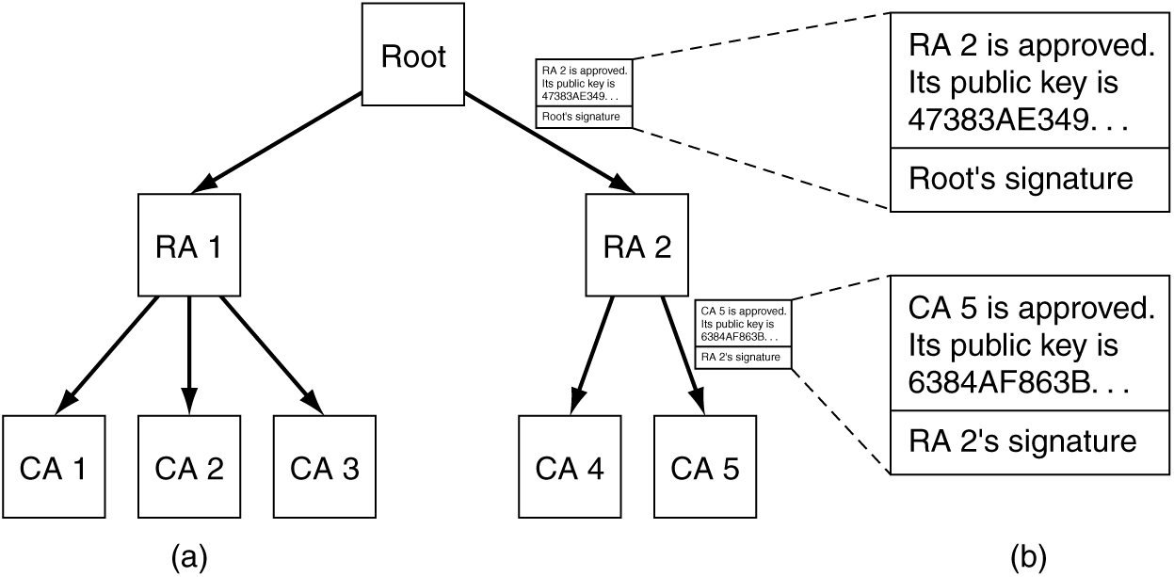
Figure 8-28. (a) A hierarchical PKI. (b) A chain of certificates.

Slide 49
Our PKI works like this:
Alice need bob’s public key and finds a certificate containing it. The certificate is signed by CA5.
She wants CA5 to prove its legitimacy, and CA5 responds with a certificate containing CA5’s public key. The certificate is signed by RA2.
Next step she want RA2 to prove its legitimacy, and RA2 responds with a certificate containing RA2’s public key. The certificate is signed by root.
Her browser might have the root’s public key built in. So the certificate signed by root is proved, and all other certificates and public keys are proved legitimate.
In fact, modern browsers come preloaded with public keys for over 100 root.

Slide 50
8.6 Communication Security
Cotent：
IPsec
Firewalls
Virtual private networks
Wireless security
802.11 security
Bluetooth security

Slide 51
8.6.1 IPsec
Two different viewpoints.
Most security expert believe that encrypt and integrity checks have to be end to end (I.e., in the application layer)
Trouble: all security-aware applications needs to be modified.
The opposite view: the network layer should authenticate and encrypt packets without user being involved.
This view won enough support that a network layer security standard (Ipsec) was defined.
Ipsec(IP security) was described in RFCs 2401,2402,2406, 2410, among others.
The complete IPsec design is a framework for multiple services, algorithms and granularities.
The main services are secrecy, data integrity, and protection from replay attacks.
Based on symmetric-key cryptography because high performance is crucial.

Slide 52
8.6.1 IPsec
The reason for Multiple granularities (间隔度，粒度):
to protect a single TCP connection.
to protect all traffic between a pair hosts.
to protect all traffic between a pair secure router.
Others
one surprising aspect of Ipsec: it is connection oriented.
A connection is called a SA (security Association), a simplex connection.
If secure traffic is needed in both direction, two SAs are required.
Two Ipsec modes:
Transport mode: The Ipsec header is inserted just after IP header.
Tunnel mode: The original IP packet is encapsulated in a new IP packet’s body with a completely new IP header.
This is useful when the tunnel ends at a location (e.g. A firewall) other than the final destination.

Slide 53
The first new header is AH (Authentication Header). It provides integrity checks, anti-replay attacks, but no secrecy. [Figure 8-27]
Next header field: to store the previous value of IP protocol field in IP header. Original IP protocol field was replaced with 51 to indicate that an AH header follows.
Payload length field: the number of 32-bit words in the AH header minus 2.
Security parameter index : the connection identifier. Inserted by the sender to indicate a record in receiver’s database.The record contains shared key and other information.
Sequence number : to number all packets sent on an SA. Every packet gets a unique number, even retransmission.
Purpose: to detect replay attacks.
Authentication data: a variable field containing the digital signature of payload and some fixed field of IP header .
The shared key (symmetric key) is used in the signature computation.
HMAC (Hashed Message Authentication Code) is used. It is much faster than “SHA-1 + RSA” signature method.
ESP in transport and tunnel mode. [Figure8-28]

Slide 54
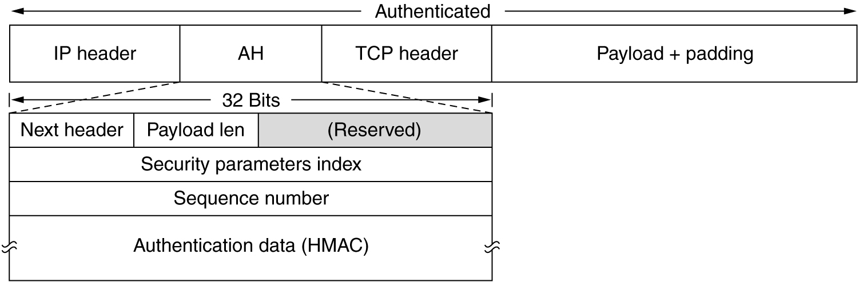
Figure 8-27.The IPsec authentication header in transport mode for IPv4.

Slide 55
The alternative Ipsec header is ESP (Encapsulating Security Payload), it uses both transport mode and tunnel mode. [Figure 8-28]
The ESP header consists of two 32-bit word
Security parameter index
Sequence number
A third word following ESP header is the Initialization vector used for encryption. If null encryption is used, it is omitted.
ESP also provides for HMAC integrity checks, as does AH.
HMAC comes after payload, this has an advantage in a hardware implementation like CRC field of Ethernet frame.

Slide 56
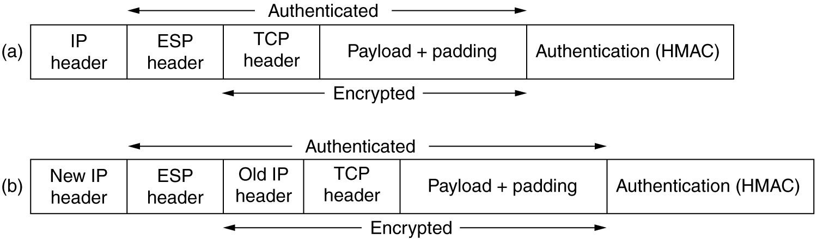
Figure8-28.(a)ESP in transport mode.(b)ESP in tunnel mode.

Slide 57
5.4.7 Firewalls
Two solutions to the danger of information leaking out and information leaking in: Encrypt、Firewall
Firewall -[see fig 8-29]
Constitute: two routers that do packet filtering and an application gateway
Packet filter
A standard router equipped with some extra functionality
The extra functionality allows every incoming or outgoing packet to be inspected and filtered.
Driven by tables configured by the system administrator, These tables list
sources or destinations that are acceptable;
sources or destinations that should be discarded;
default rule (discard or forward) for other addresses.
source or destination ports that are acceptable;
source or destination ports that should be discarded;

Slide 58
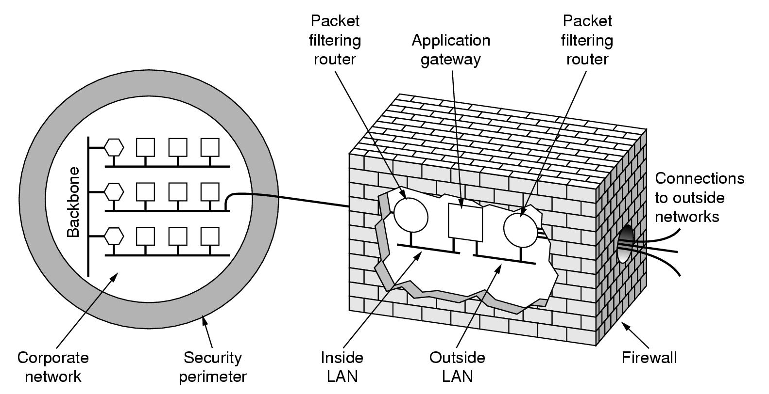
Figure 8-29. A firewall consisting of two packet filters and an application gateway.

Slide 59
5.4.7 Firewalls
Application gateways: The gateway operates at the application level.
E.g., a mail gateway will check mail’s header field, message size, or even content to decide whether to discard it.
DoS (Denial of Service): attack’s goal is to shutdown the target rather than steal data. Usually the attack packet has false source addresses.

Slide 60
8.6.3 Virtual Private Networks
A network built up from company computers and leased telephone lines is called a private network. [Fig 8.30(a)]
VPNs(Virtual Private Networks) are overlay networks on top of public networks but with most of the properties of private networks.
A common design is to
equip each office with a firewall and
create tunnels through the Internet between all pairs of offices,as illustrated in [Fig 8.30(b)].
Tunnel begins and ends at the firewall.
IPsec is usually used for the tunnel.
The tunnel is a authenticated, encrypted SA (Security Association).
A key advantage of organizing a VPN this way is that it is completely transparent to all user software. The only person who is even aware of this setup is the system administrator.

Slide 61
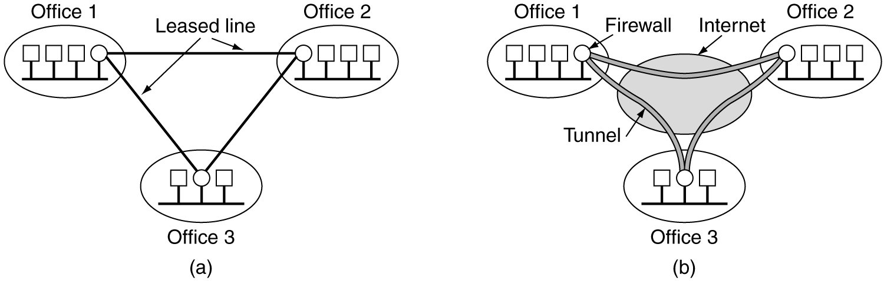
Figure 8-30. (a)A leased-line private network. (b) A virtual private network.

Slide 62
8.6.4 Wireless Security
when some machines are wireless and use radio communication,
Using VPNs will leak like a sieve;
wireless traffic may pass over the firewall in both directions.
802.11 Security
The 802.11 standard prescribes a data link-level security protocol called WEP (Wired Equivalent Privacy),
It is designed to make the security of a wireless LAN as good as that of a wired LAN.
WEP encryption uses a stream cipher based on the RC4 algorithm.
But it was completely broken as many researchers found the weaknesses in RC4 itself.

Slide 63
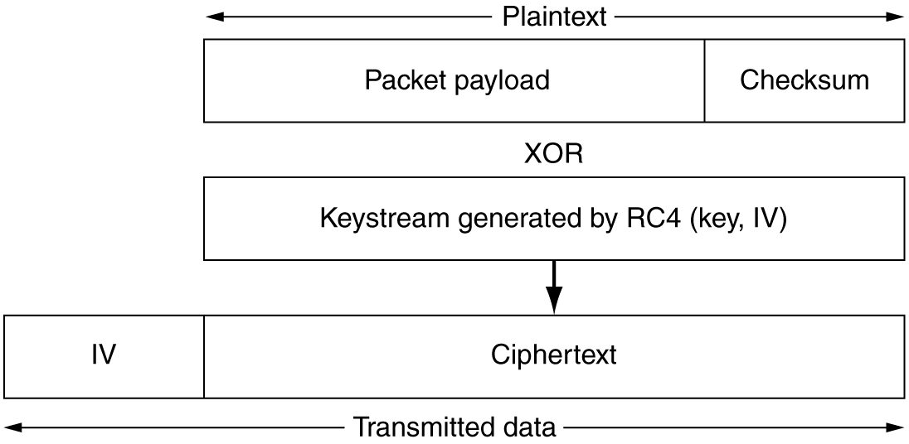
Figure 8-31.Packet encryption using WEP.

Slide 64
Bluetooth
Bluetooth has three security modes,ranging from nothing at all to full data encryption and integrity control.
Bluetooth provides security in multiple layers.
In physical layer,when the newly-arrived slave asks for a channel with the master,they shared a secret key set up in advance.
Bluetooth also implements security in the upper layers.
WAP 2.0 Security
WAP2.0 largely uses standard protocols in all layers.
It supports full use of IPsec in the network layer, since it is IP based.
In the transport layer,TCP connections can be protected by TLS.
Application-layer crypto libraries provide for integrity control and nonrepudiation.
Its security services, in particular, privacy,authentication, integrity control and nonrepudiation may fare better than 802.11 and Bluetooth security,

Slide 65
8.7 Authentication protocols
Authentication is the technique by which a process verifies that its communication partner is who it is supposed to be and not an imposter (冒名顶替者).
authorization: what the process is permitted to do.
The general model for authentication protocols, concepts
principals: Alice and Bob
key distribution center(KDC)
session key: Alice and Bob establish a secret session key for use in the upcoming conversation.
For performance reason, all data traffic is encrypted using secret-key (session key) cryptography, e.g. DES, AES,IDEA,
although public-key cryptograph (such as RSA), is widely used for the authentication protocol and for establish the session key.

Slide 66
8.7 Authentication protocols
8.7.1 Authentication based on a Shared Secret Key
principle：one party sends a random number to the other, who then transforms it in a special way and then returns the result.（challenge-response protocols）
Two-way authentication using a challenge-response protocol-[see fig 8-32]
A shortened two-way authentication protocol-[see fig 8-33]
Can defeat this protocol by using what is known as a reflection attack. -[see fig 8-34]
A reflection attack on the protocol of Fig.8-32.-[see fig8-35]

Slide 67
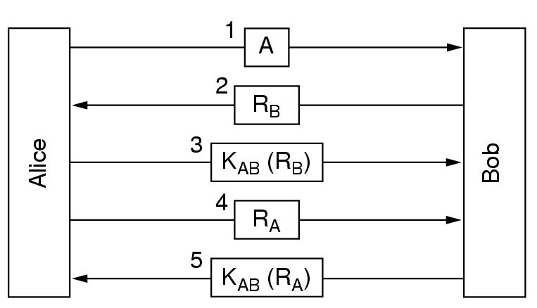
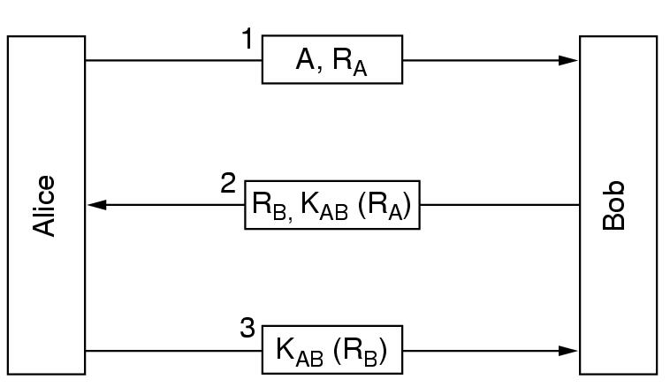
Fig. 8-32. Two-way authentication using a challenge-response protocol
Fig. 8-33. A shortened two-way authentication protocol.

Slide 68
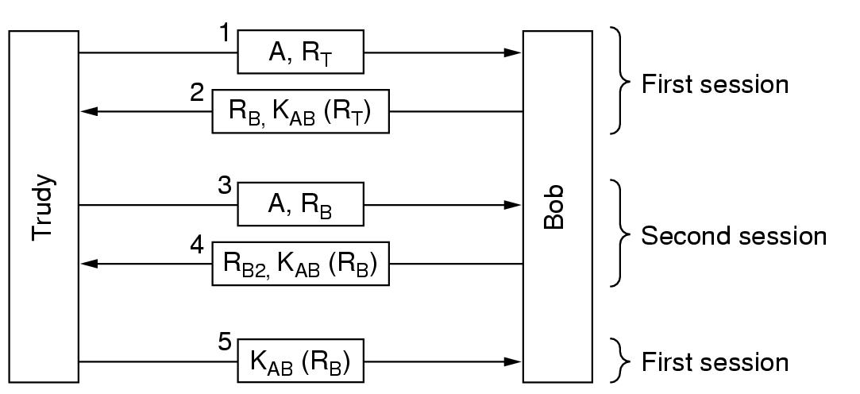
Fig. 8-34. The reflection attack.

Slide 69
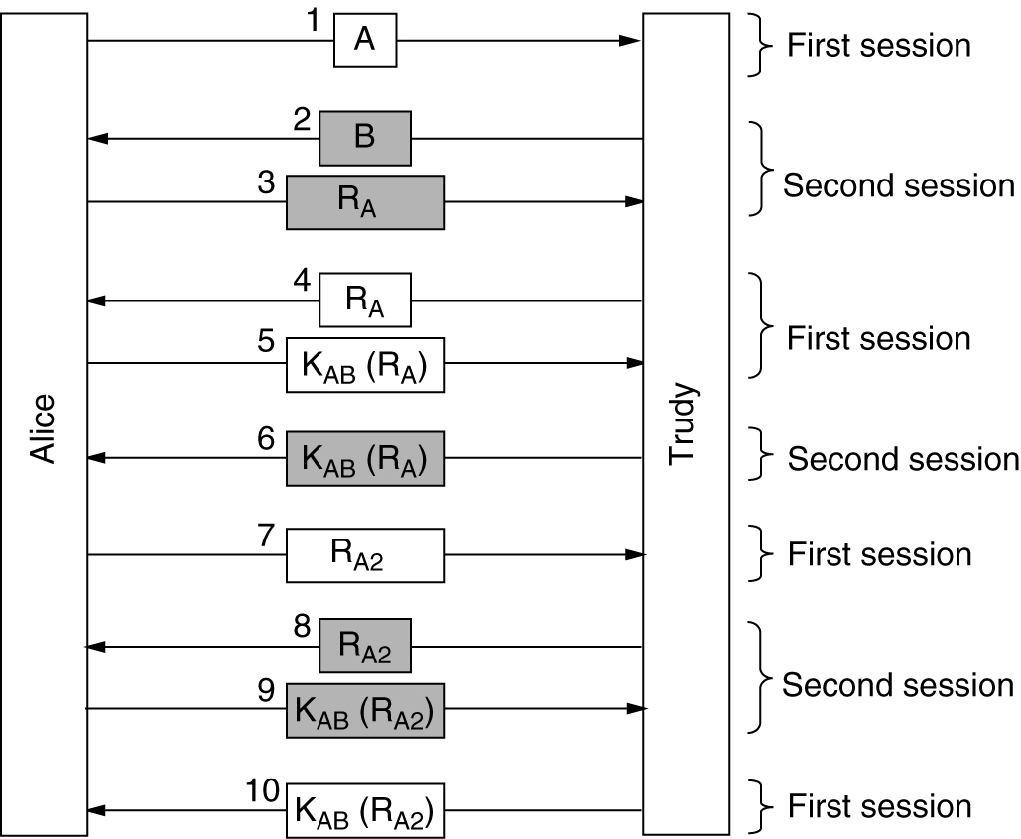
Fig.8-35.A reflection attack on the protocol of Fig.8-32

Slide 70
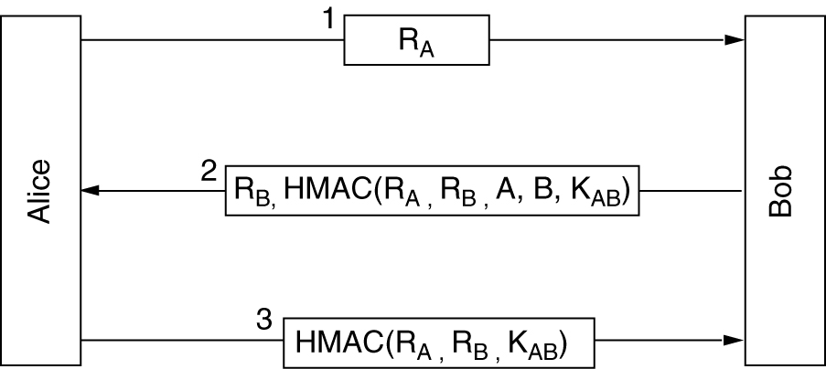
Authentication using HMACs.-[see fig 8-36]
HMAC (Hashed Message Authentication Code) is message digest such as SHA-1.
An alternative scheme that is often used instead of computing the HMAC over a series of items is to encrypt the items sequentially using cipher block chaining.
Fig.8-36.Authentication using HMACs.

Slide 71
8.7 Authentication protocols
8.7.2 Establishing a Shared Key:The Diffie-Hellman key Exchange
•principle：
–select publicly large numbers n，g, (n-1)/2, (g-1)/2, n is a prime number
–One choose x secretly, the other select y.
–Then begin to exchange the keys-[see fig 8-37]
•passing queue attack-[see fig 8-38]
Also known as bucket brigade attack, or (wo)man-in-the-middle attack.

Slide 72
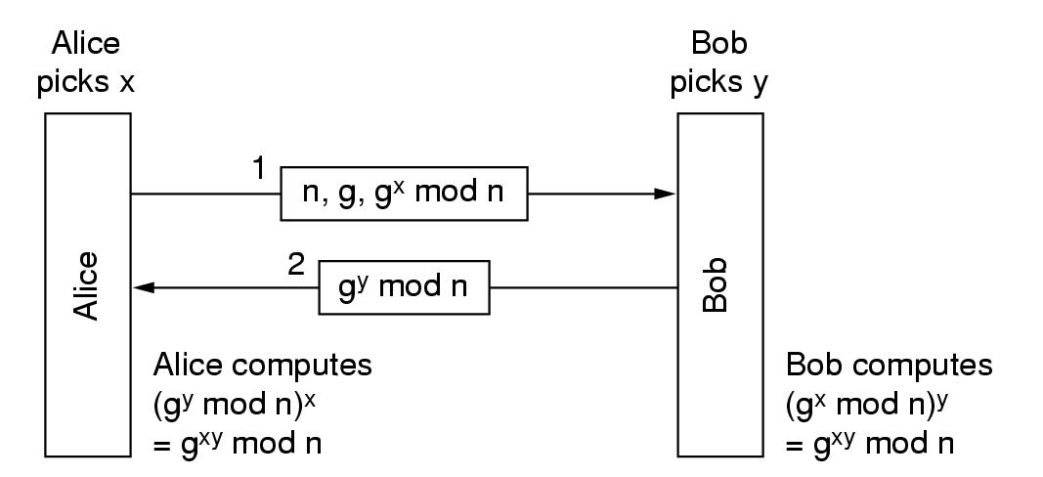
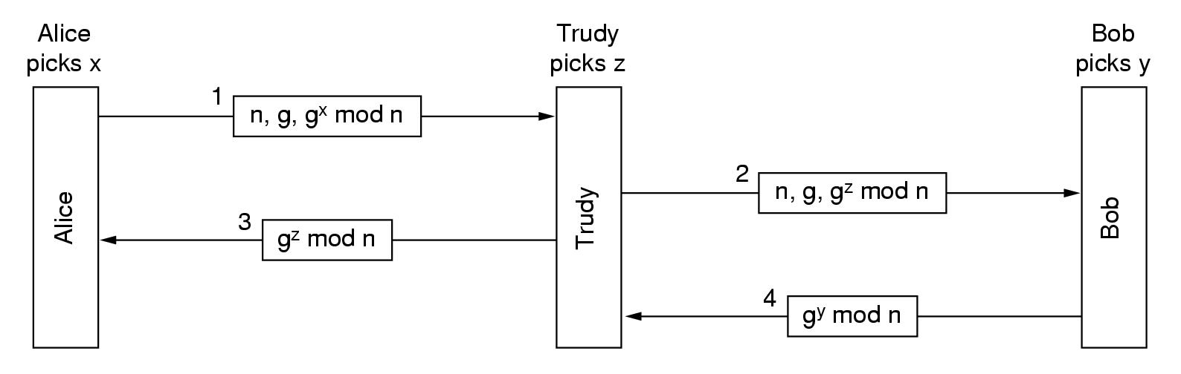
Fig. 8-37. The Diffle-Hellman key exchange.
Fig. 8-38. The bucket brigade attack.

Slide 73
8.7 Authentication protocols
8.7.3 Authentication Using a Key Distribution Center
The simplest known KDC authentication protocol：wide-mouth frog-[see fig 8-39]
KDC is used to distribute session key K_{S}
K_{S}----session key between Alice and Bob, selected by Alice
K_{A}----Secret key that Alice shares (only) with the KDC
K_{B}----Secret key that Bob shares (only) with the KDC
Having a serious flaw – replay attack
solution：
To include a timestamp in each message
To put a one-time, unique message number, usually called a nonce, in each message.
To combine these two solutions above together.
Multiway challenge-response protocol – a more mature solution
Needham-Schroeder authentication protocol-[see fig 8-40]
Otway-Rees protocol-[see fig 8-41]

Slide 74
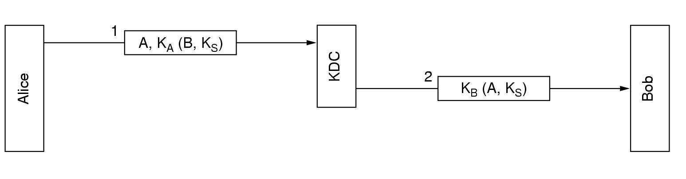
K_{S}----session key between Alice and Bob, selected by Alice
K_{A}----Secret key that Alice shares (only) with the KDC
K_{B}----Secret key that Bob shares (only) with the KDC
Fig. 8-39. A first attempt at an authentication protocol using a KDC.

Slide 75
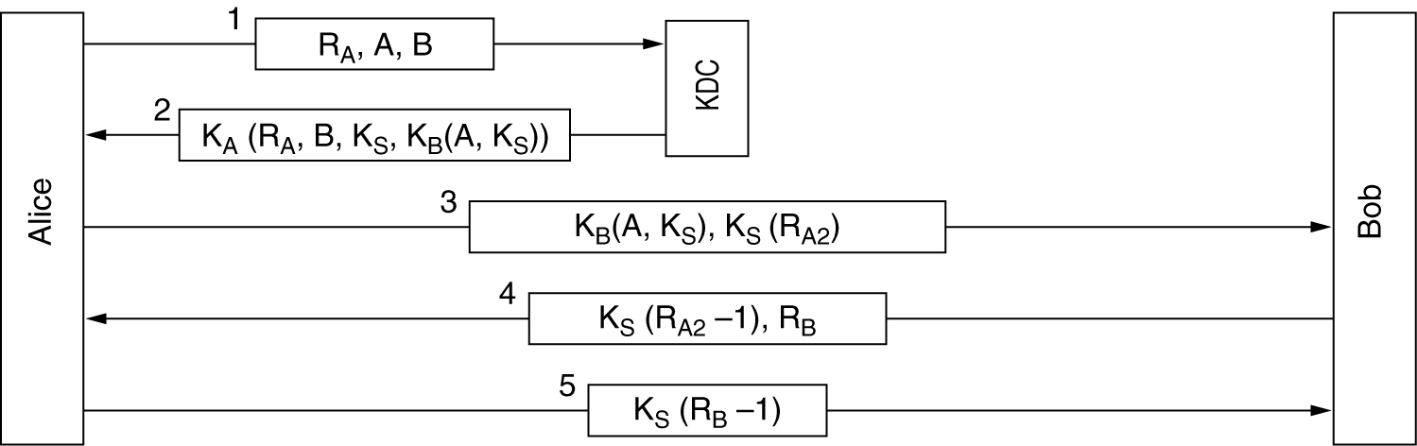
Fig.8-40. The Needham-Schroeder authentication protocol.

Slide 76
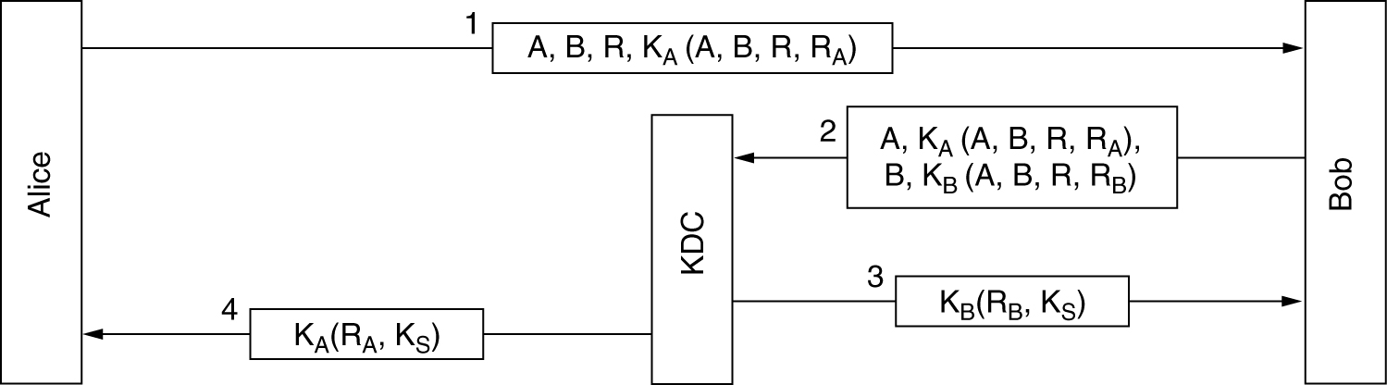
Fig.8-41.The Otway-Rees authentication protocol (slightly simplified).

Slide 77
8.7.4 Authentication Using Kerberos
Based on a variant of Needham-Schroder.
Difference：assuming that all clocks are fairly-well synchronized.
principle-[see fig 8-42]
K_{A}---- Password shared by Alice and AS
K_{B}---- Password shared by Bob and AS
K_{TGS}---TGS’s secret key shared by AS and TGS,
K_{TGS}(A, K_{S})--- Encrypted A and K_{S} using K_{TGS} to encrypt
K_{S}---- Session key between Alice and TGS
K_{B}(A, K_{AB}) ----Ticket issued to Alice by TGS, so that Alice can communicate with Bob
K_{AB} ---- session key between Alice and Bob

Slide 78
8.7.4 Authentication Using Kerberos
Kerberos involves three servers in addition to a client workstation:
Authentication Server(AS)：verifies users during login
Ticket-Granting(发放许可证) Server(TGS)(TGS):issues “proof of identity tickets”
Bob the server：actually does the work Alice wants performed
Characteristics：difficult to attack（because of timestamp）、simple password

Slide 79
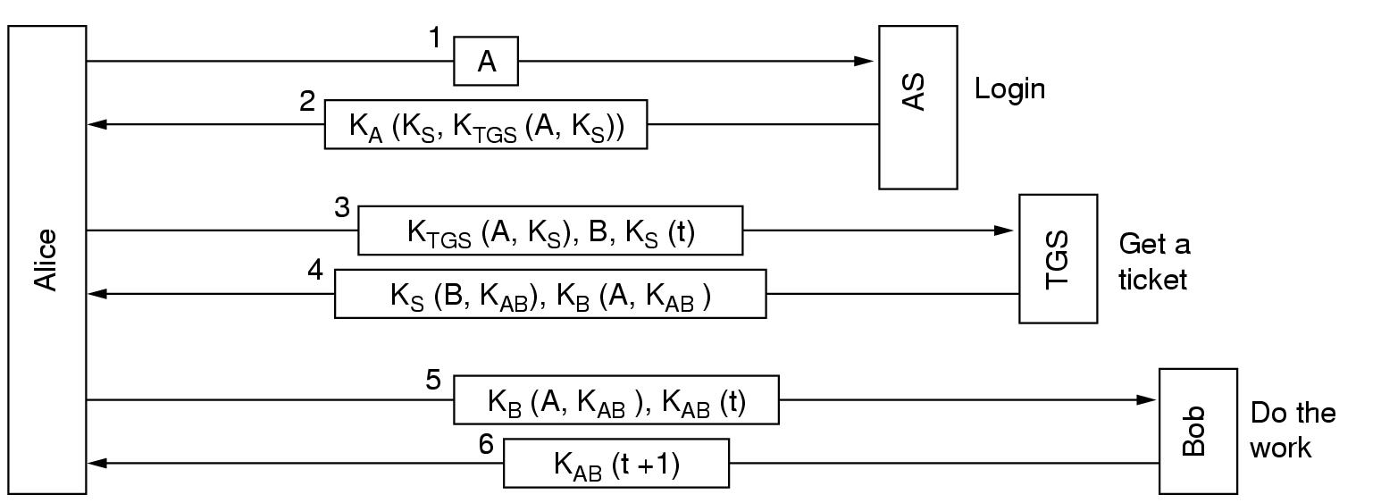
K_{A}---- Password shared by Alice and AS
K_{B}---- Password shared by Bob and AS
K_{TGS}---TGS’s secret key, K_{TGS}(A, K_{S})--- Encrypted A and K_{S} using K_{TGS} to encrypt
K_{S}---- Session key between Alice and TGS
K_{B}(A, K_{AB}) ----Ticket issued to Alice by TGS, so that Alice can communicate with Bob
K_{AB} ---- session key between Alice and Bob
Fig. 8-42. The operation of Kerberos V4.

Slide 80
8.7 Authentication protocols
8.7.5 Authentication Using Public-Key Cryptography
Important condition(weakness)：it assumes that Alice and Bob already know each other’s public keys.
The process of authenticating each other-[see fig 8-43]
characteristics：difficult to attack.

Slide 81
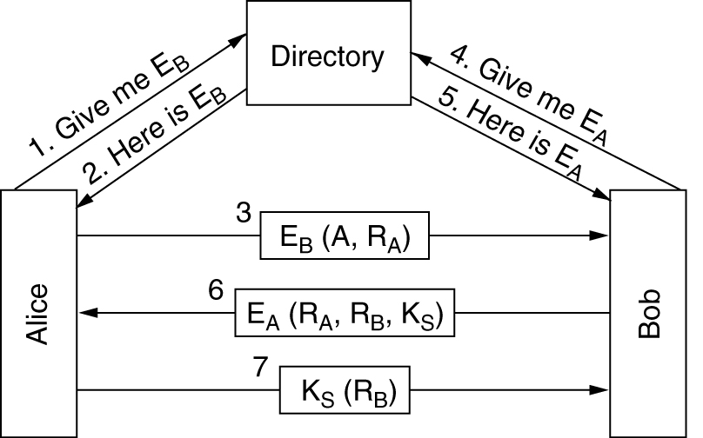
Fig. 8-43. Mutual authentication using public-key cryptography.

Slide 82
8.8 E-mail Security
8.8.1 PGP –pretty good privacy
Secure email systems: PGP and PEM
PGP –pretty good privacy. Phil Zimmermann. It provides：
privacy、authentication、digital signature and compression
software、source code distributed free of charge
Uses existing cryptographic algorithms. Based on：RSA、IDEA and MD5.
PGP operation for sending a message.-[see fig 8-44]

Slide 83
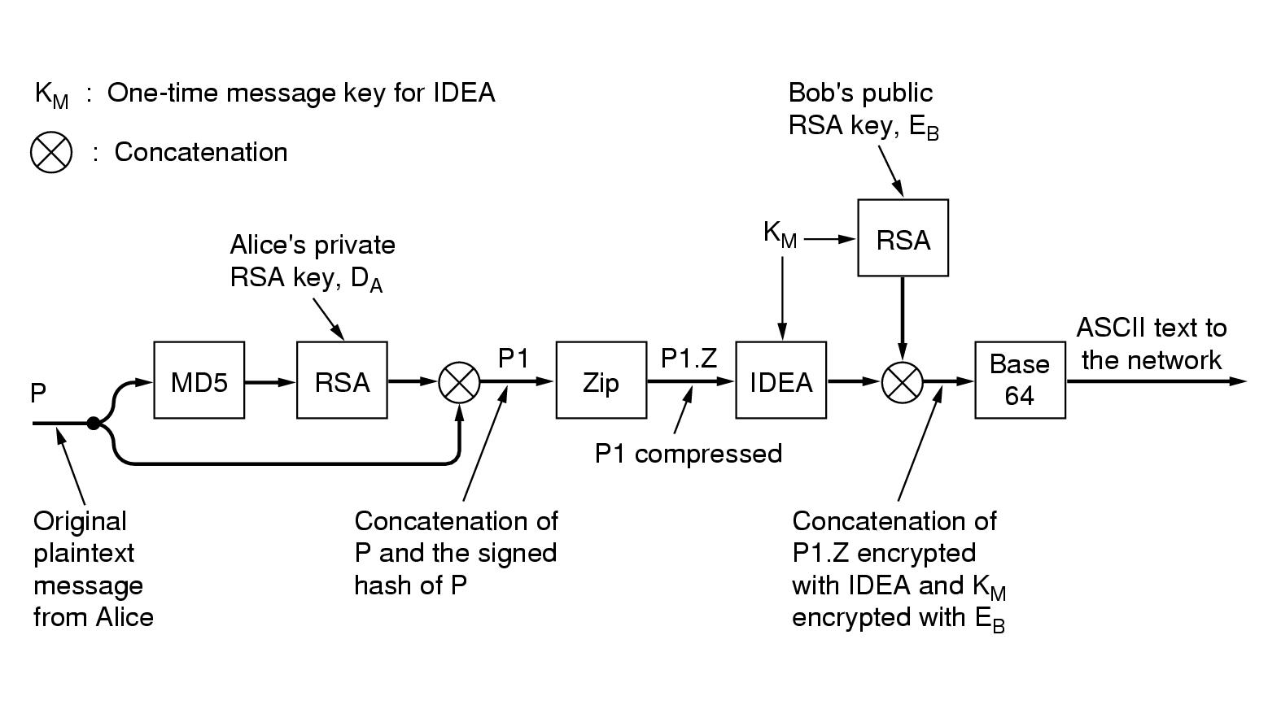
Fig.8-44. PGP in operation for sending a message.

Slide 84
8.8 E-mail Security
8.8.2 PEM --Privacy enhanced Mail
– PEM (Privacy enhanced Mail)
An official Internet standard (RFC1421-1424)
Messages sent using PEM are first converted to canonical form (关于空格,制表符,CR,LF等的规范化表示), so they all have the same conventions about white space and the use of carriage returns and line feeds. Next,a message hash is computed using MD2 or MD5
Each message is encrypted with a one-time key that is enclosed along with the message. The key can be protected either with RSA or with triple DES using EDE.
Keys are managed by certification authorities
A comparison of PGP and PEM-[see fig next page]

Slide 85
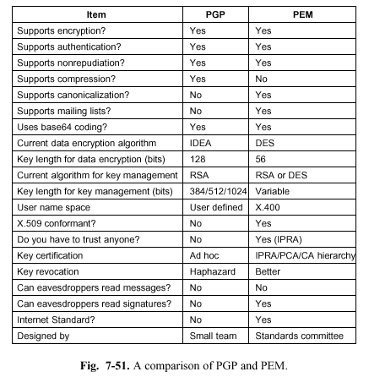

Slide 86
8.9 WEB SECURITY
Web security can be divided into three parts
First, how are objects and resource named securely?
Second, how can secure, authenticated connections be established?
Third ,what happens when a Web site sends a client a piece of executable code?

Slide 87
8.9 WEB SECURITY
8.9.1 Threats
Web site security problems is really pretty grim
Examples:
Attacked by crackers (usually called “hackers”)
Denial-of-service attacks
8.9.2 Secure Naming
The classic man-in-the-middle attack:
Alice wants to visit Bob’s Web site, but Trudy intercepts her outgoing packets , when Trudy captures a request to Bob’s Web site , she could go to Bob’s Web site to get the page, modify Bob’s Web site page as she wishes , and return the fake page to Alice.
The disadvantage: Trudy has to tap either Alice’s phone line or bob’s.

Slide 88
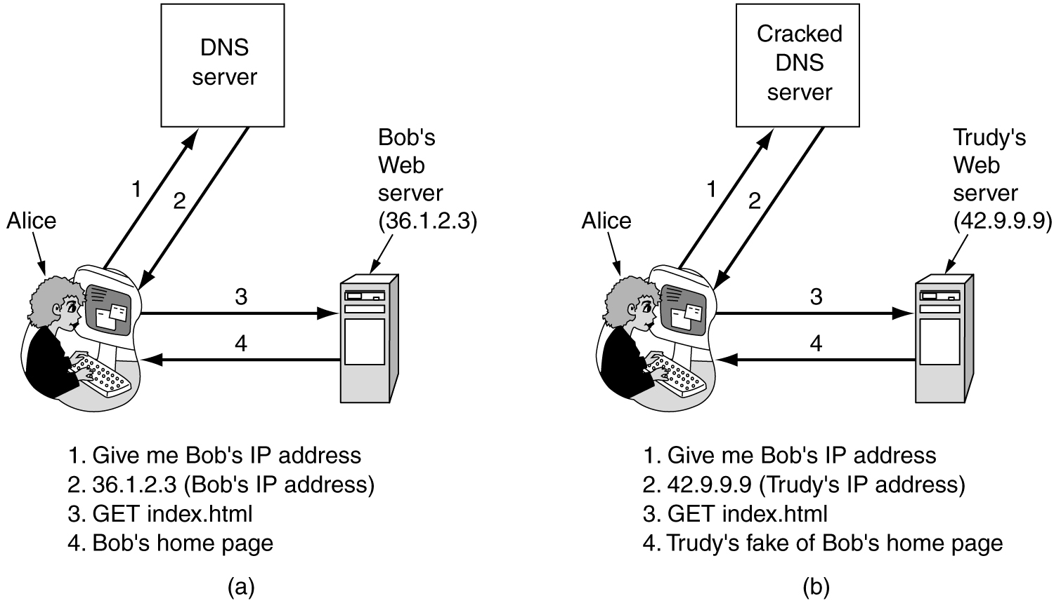
8.9 WEB SECURITY
Figure 8-46.(a) Normal situation. (b) An attack based on breaking into DNS and modifying Bob's record.

Slide 89
8.9 WEB SECURITY
DNS Spoofing
How might Trudy fool DNS?
Because DNS uses UDP,the DNS server could not check who supplied the answer.
The Attack Procedure:
1.Trudy sends a request to Alice’s ISP asking for the IP address of bob.com;
2.Trudy beats the .com sever to the punch and send back the false IP address “42.9.9.9” which is hers;
3.The false reply gets back to Alice ISP earlier, that one will be cached and the real reply will be rejected.
DNS spoofing: Tricking a DNS sever into installing a false IP
address.
Poisoned cache: A cache that holds an intentionally false IP
address.

Slide 90
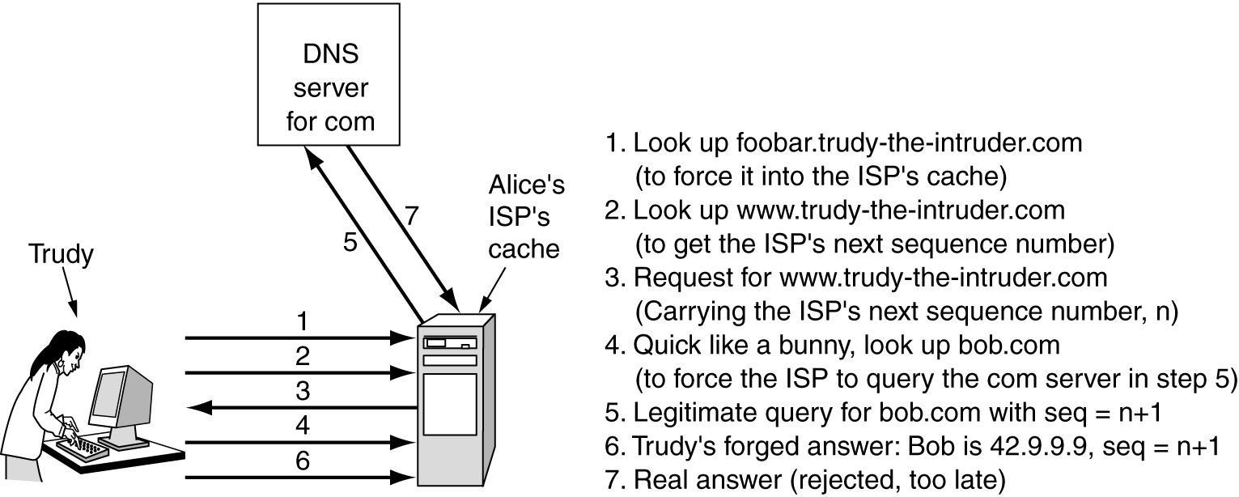
How Trudy spoofs Alice’s ISP? (two difficulties)
ISP will check if the reply bears the correct IP source address of the top-level server.
Trudy may easily set the address
All requests carry a sequence number.
Trudy registers a domain herself, trudy-the-intruder.com
Procedure:[see Fig 8-47]
Figure 8-47. How Trudy spoofs Alice's ISP

Slide 91
8.9 WEB SECURITY
Secure DNS
DNSsec offers three services:
Proof of where the data originated
Public key distribution
Transaction and request authentication
RRsets(Resource Record Sets)
DNS records (having the same name, class and type) are grouped into sets called RRsets
It can be appended KEY record and SIG record
DNSsec introduce some new record types
KEY record: Holds the public key, user, host , cryptographic algorithm, transmission protocol and a few other bits
SIG record: Holds the signed hash according to the algorithm specified in the KEY record

Slide 92
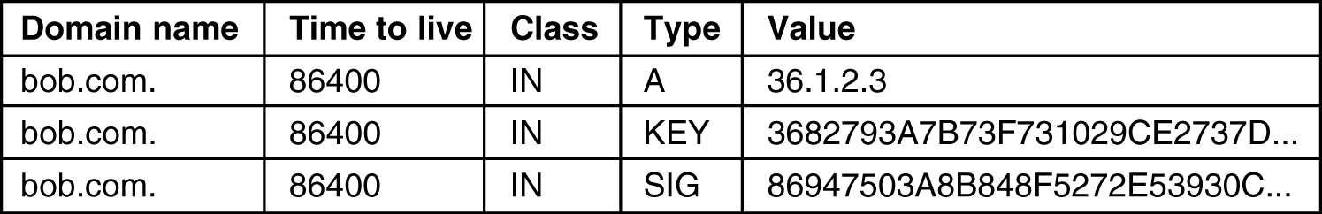
8.9 WEB SECURITY
An example:
Figure 8-48. An example RRSet for bob.com. The KEY record is Bob's public key. The SIG record is the top-level com server's signed has of the A and KEY records to verify their authenticity.
How does Alice get www.bob.com’s ip addesss securely?
Alice is preconfigured with all top-level domain server’s public key.
Alice asks for the RRset of bob.com, the reply RRset is signed by .com top-level domain server, and contains public key of bob.com domain.
Alice then asks indirectly Bob’s DNS server for IP addr. of www.bob.com, and gets a reply RRset signed by Bob’s public key .
It is impossible for Trudy to spoof the DNS server now.

Slide 93
8.9 WEB SECURITY
Self-Certifying Names
This approach is used in the Secure File System
A secure, scalable, worldwide file system
Without modifying (standard) DNS
Without using certificates or assuming the existence of a PKI
self-certifying URL
Assuming each Web sever has a public/private key pair.
Each URL contains a cryptographic hash of the sever’s name and public key
Example:
Figure 8-49. A self-certifying URL containing a hash of server's name and public key.

Slide 94
What is the hash for?
The hash is computed by concatenating the DNS name of the sever with the sever’s public key, using the SHA-1 function
[see Fig8-49]
Tow ways to see Bob’s photo
Just type the string of Fig 8-49 to browser;
Connect to a trusted search engine to get self-certifying URL;
After the browser is given the URL, it ask sweb server for its public key, and checks whether the key match hash.
If they match, Alice sends to Bob a session key encrypted with Bob’s public key, and their session would begin.
How to stands up to Trudy’s DNS spoofing?
The protocol requires the a public key to produces the correct hash.
If Trudy returns her own public key, Alice will detect it because SHA-1 hash will not match.
If Trudy returns Bob’s public key, Alice will encrypt her message with Bob’s key. Trudy will get the message, but she can’t decrypt it.

Slide 95
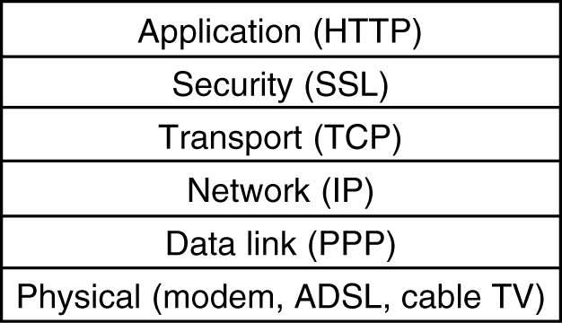
8.9 WEB SECURITY
8.9.3 SSL —— The Secure Sockets Layer
SSL builds a secure connection between two sockets,
Parameter negotiation between client and sever;
Mutual authentication of client and sever;
Secret communication;
Data integrity protection
SSL is a new layer interposed (插入) between the application layer and the transport layer [see Fig 8 -50]
Fig 8-50. Layers (and protocols) for a home user browsing with SSL.

Slide 96
8.9 WEB SECURITY
SSL consists of two subprotocols
One subprotocal for establishing a secure connection
The second subprotocol is used for actual transport
The procedure to establish a secure connection :
Message 1, Alice sends a connection request to Bob, specifies her SSL version, preferences and R_{A};
Message 2, Bob choose a algorithm,sends his own nonce,R_{B};
Message 3, Bob sends a certificate containing his public key;
Message 4, Bob tells Alice that he is done;
Message 5, Alice chooses a random 384-bit premaster key and sending it to Bob encrypted with his public key; RSA or Diffie-Hellman algorithm could be used.
Message 6, Alice tells Bob to switch to the new cipher;
Message 7, Alice tells Bob that she has finished;
Message 8, Bob replies he has changed cipher;
Message 9, Bob replies he has also finished. [see Fig 8-51]

Slide 97
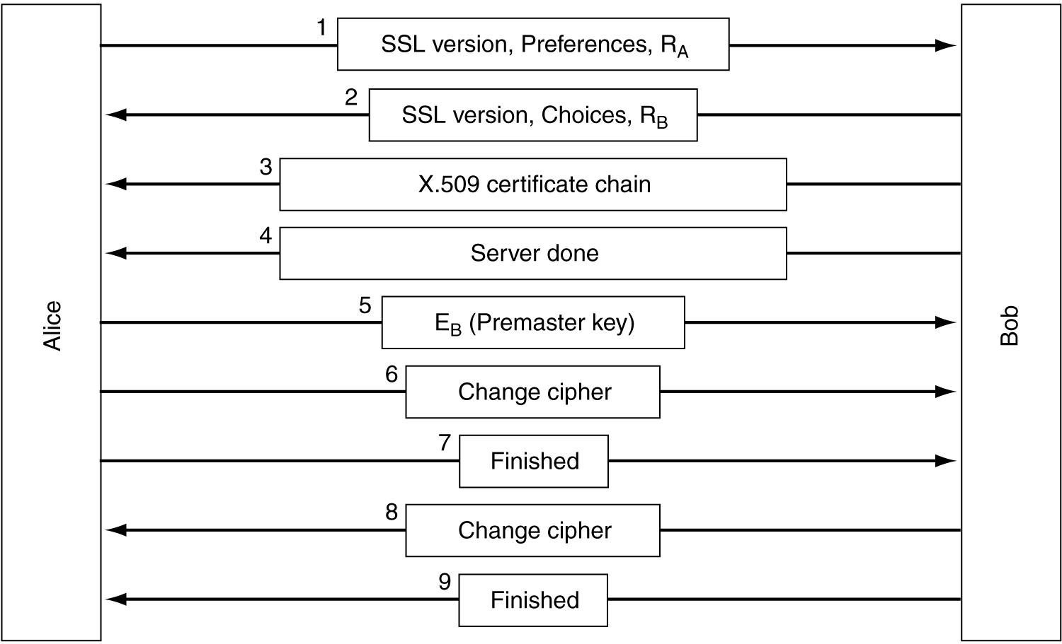
8.9 WEB SECURITY
Figure 8-51. A simplified version of the SSL connection establishment subprotocol.

Slide 98
The second subprotocol is used for actual transport
The procedure:
Messages are first broken into units;
Each unit is separately compressed;
A secret key derived from the two nonces(RA, RB) and the premaster key is concatenated with the compressed text and the result is hashed as the MAC;
MD5 or SHA-1 is usually used.
The compressed fragment plus MAC is encrypted with symmetric encryption algorithm, (usually by XORing it with RC4 keystream);
DES, triple DES, or RC5, are also possible.
A fragment header is attached, and then fragment is transmitted over the TCP connection.[see Fig 8-52]
IN 1996, SSL has been turned over to IETF for standardization.The result was TLS (Transport Layer security), which is described in RFC 2246

Slide 99
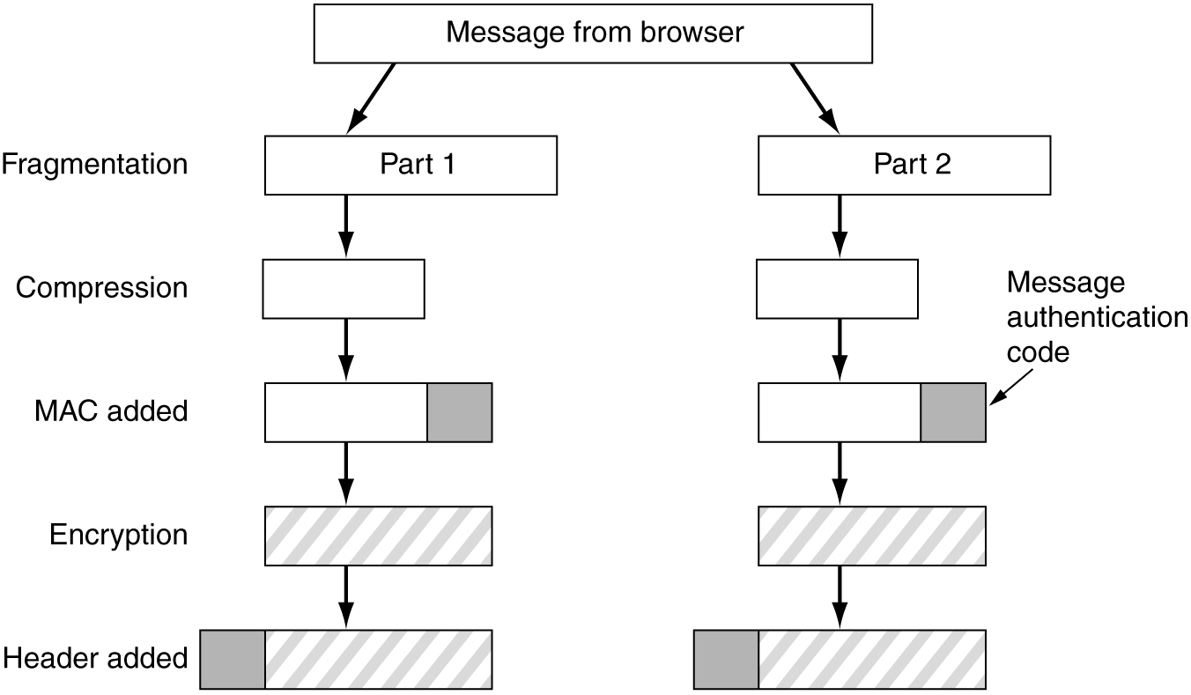
8.9 WEB SECURITY
Figure 8-52. Data transmission using SSL.

Slide 100
8.9.4 Mobile Code Security
Web pages often contain mobile code. Mobile code is small program, including Java applets, ActiveX controls, and JavaScripts.
Java Applets Security
Java applets are small Java programs compiled to a stack-oriented machine language call JVM (Java Virtual Machine).
The applets are usually inserted into a JVM interpreter inside the browser. [ Fig 8-53]
Every instruction is examined by the interpreter before being executed.
If an applet is not trusted, it is encapsulated in sandbox to restrict its behavior.
When an applets tries to use a system resource, its call is passed to a security monitor for approval.
The monitor examines the call in light of the local security policy, and then makes a decision to allow or reject it.

Slide 101
8.9 WEB SECURITY
ActiveX
ActiveX controls are Pentium binary programs that can be embedded in Web pages.
When one of them is encountered, it is checked whether to execute it.
The check is based on code signing, an idea from Microsoft.
Each ActiveX control is accompanied by a digital signature----a hash of the code signed by its creator using public key cryptograph.
Before executing an ActiveX control, browser first checks its signature to verify its integrity.
Then browser checks its internal table to see if the program’s creator is trusted or there is trust chain back to a trusted person.
If both checks pass, the control is executed.

Slide 102
8.9 WEB SECURITY
JavaScript
ActiveX controls are Pentium binary programs that can be embedded in Web pages.
JavaScript does not have any formal security model, but it does have a long history of leaky (有漏洞的) implements.

